Slide 1
Breadth First Search (BFS) &
Depth First Search (DFS)
Graph Traversal in Design and Analysis of Algorithms
Swarupa Shinde
Division [C]
PRN: 25070521131
Subject: Design and Analysis of Algorithms
Generated using Gemini AI

Slide 2
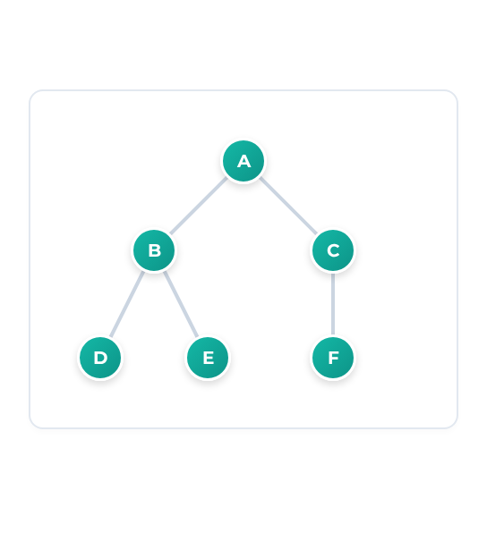
Graph Traversal Basics
Graph Structure: Collection of connected vertices (nodes) and edges.
Traversal Definition: Systematic process of visiting every graph vertex.
Core Algorithms: BFS and DFS form the foundation of graph searching.
Goal: Discover paths, components, or specific target nodes.
Standard Undirected Graph G = (V, E)
Generated using Gemini AI

Slide 3
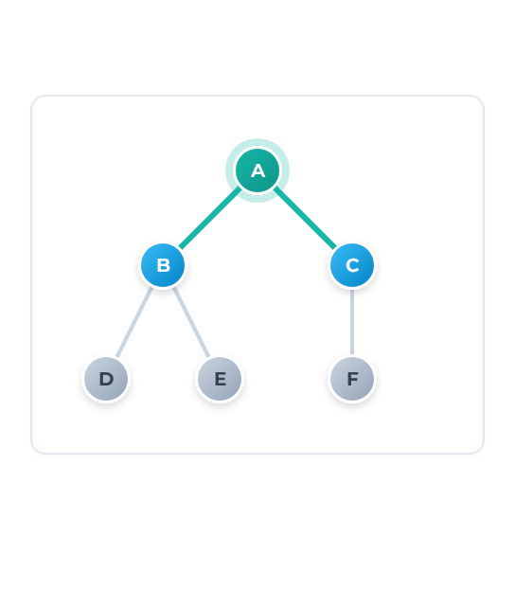
Breadth First Search (BFS)
Exploration Strategy: Scans graph level by level.
Data Structure: Queue (First-In, First-Out).
Visited Tracking: Marks nodes to prevent infinite cycles.
Source Vertex: Execution begins from a defined root.
Visual: Expanding Level 1 Neighbors
Generated using Gemini AI

Slide 4
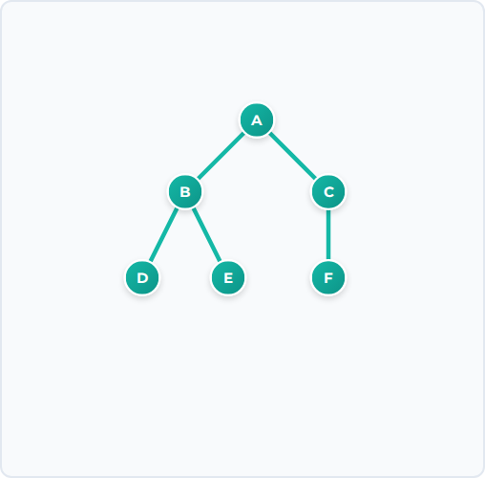
BFS Algorithm & Traversal Trace
BFS(G, start_node): queue = empty Queue queue.enqueue(start_node) mark start_node as visited while queue is not empty: current = queue.dequeue() print current for neighbor in G.adj[current]: if neighbor not visited: mark neighbor as visited queue.enqueue(neighbor)
A → B → C → D → E → F
Queue state:
D
E
F
← In
Generated using Gemini AI

Slide 5
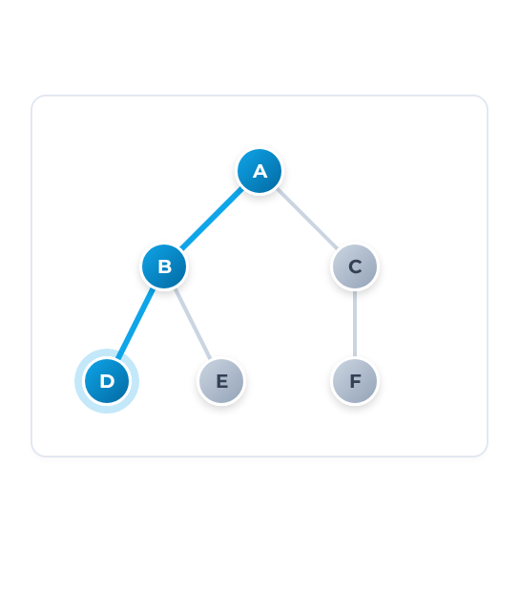
Depth First Search (DFS)
Exploration Strategy: Dives deep into one branch before backtracking.
Data Structure: Stack (Last-In, First-Out) or Recursion.
Backtracking: Returns to previous node when dead-end is reached.
Visited Tracking: Essential to prevent infinite looping.
Visual: Deep branch exploration (A → B → D)
Generated using Gemini AI

Slide 6

DFS Algorithm & Traversal Trace
DFS(node, visited_set): if node not in visited_set: print node add node to visited_set for neighbor in G.adj[node]: DFS(neighbor, visited_set) // Initial call: DFS(A, empty_set)
Call Stack
E
B
A → B → D → E → C → F
Recursive calls mimic Stack (LIFO) behavior. Backtracking occurs at leaves (D, E, F).
A
Generated using Gemini AI

Slide 7
BFS vs DFS Comparison
Parameter | Breadth First Search (BFS) | Depth First Search (DFS)
Traversal Approach | Level by level (Horizontal) | Deepest branch first (Vertical)
Data Structure | Queue (FIFO) | Stack (LIFO) or Recursion
Shortest Path | Optimal for unweighted graphs | Does not guarantee shortest path
Memory Usage | High (Stores entire level widths) | Low (Stores single path depth)
Time Complexity | O(V + E) using Adjacency List
*V = Number of Vertices, E = Number of Edges
Generated using Gemini AI

Slide 8
Algorithmic Applications
BFS Applications
DFS Applications
Shortest Paths: Finding optimal routes in unweighted graphs.
Cycle Detection: Identifying infinite loops in graphs.
Social Networks: "People you may know" or 6-degrees separation.
Topological Sorting: Task scheduling and dependency resolution.
Tree Traversal: Level-order processing in hierarchical data.
Maze Solving: Backtracking algorithms to find viable paths.
Broadcasting: Packet routing in peer-to-peer networks.
Connected Components: Grouping isolated sub-graphs.
Generated using Gemini AI

Slide 9

Key Takeaways
BFS
DFS
O(V + E)
Explores horizontally (Queue). Best for shortest paths.
Explores vertically (Stack). Best for cycles and backtracking.
Fundamental traversal bounds for algorithm design.
Thank You
Standard DAA graph traversal concepts.
Generated using Gemini AI

